Slide 1

QE Training Program
Karime Salomon Zarate

Slide 2
Ruby gems installation
Gems commands
From Ruby’s installation folder:
gem install <gem_name>
gem list
gem_name --version
gem search –l <gem_name_pattern>
gem uninstall <gem_name>
Practice :
Install cucumber gem.
List all gems installed
List ccumber version installed
Perform any search in your gems installed
Uninstall the gem

Slide 3
Recursive uninstall
Create a ruby file that read the resulti of all gems listed and execute the uninstall command :
'gem list'.split(/$/).each { |line|
puts `gem uninstall -Iax #{line.split(' ')[0]}` unless line.empty?
}

Slide 4
Gems installation using bundler
What is bundler?
Bundler provides a consistent environment for Ruby projects by tracking and installing the exact gems and versions that are needed.
Why it is useful?
Bundle let you share your gem installation snapshot, so that anybody could have your exact configuration, including version you need in development, testing, and production environment.
GemFile and GemFile lock are files that will be read by bundle
How to use is?
In ruby folder : gem install bundler
In GemFile location : bundle install

Slide 5
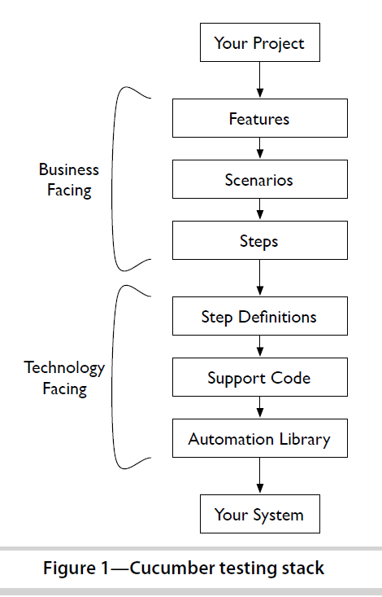
What is cucumber
Cucumber is a command-line tool. When you run it, it reads in your specifications
from plain-language text files called features, examines them for
scenarios to test, and runs the scenarios against your system.
Each scenario is a list of steps for Cucumber to work through.

Slide 6
Framework desing
Feature files
Gherkin
Step definitions
ruby
Methods, helpers, hooks
ruby

Slide 7

Cucumber structure
Lets start with it :
Cucumber --init
How cucumber understand plain text?
Cucumber can understand the feature files following some basic syntax rules. The name
for this set of rules is Gherkin.

Slide 8
Gherkins?
Gherkin is the language that Cucumber understands. It is a Business Readable, Domain Specific Language that lets you describe software’s behaviour without detailing how that behaviour is implemented.
Gherkin serves two purposes — documentation and automated tests. The third is a bonus feature — when it yells in red it’s talking to you, telling you what code you should write.
Gherkin’s grammar exists in different flavours for many spoken languages (around 37), so that your team can use the keywords in your own language.

Slide 9
Gherkin
Dry Run
In order to know if our gherkins is valid or not, cucumber provides dry run option.
Into your feature folder add an empty file “test.feature”
Open CMD and go to your cucumber folder
Execute the command :
$ cucumber test.feature --dry-run
The --dry-run switch tells Cucumber to parse the file without executing it. It
will tell you if your Gherkin isn’t valid.

Slide 10
Gherkin Keywords
A Gherkin file is given its structure and meaning using a set of special keywords:
Feature
Background
Scenario
Given
When
Then
And
But
*
Scenario Outline
Examples

Slide 11
Gherkin Feature
Each Gherkin file begins with the Feature keyword.
This keyword doesn’t really affect the behavior of your Cucumber tests at all; it just gives you a convenient
place to put some summary documentation about the group of tests that follow.
Here’s an example:
Feature: This is the feature title
This is the description of the feature, which can span multiple lines.
You can even include empty lines, like this one:
In fact, everything until the next Gherkin keyword is included in the description.
The text immediately following on the same line as the Feature keyword is the
name of the feature, and the remaining lines are its description.
You can include any text you like in the description except a line beginning with one
of the words Scenario, Background, or Scenario Outline
Practice
Run the example described with a similar feature description, and dry-run to review if the correct gherkin is displayed.

